Slide 1



Assignment4_Team1
View in Power BI
Last data refresh:
7/2/2018 12:54:36 PM Atlantic Standard Time
Downloaded at:
7/2/2018 12:58:02 PM Atlantic Standard Time

Slide 2
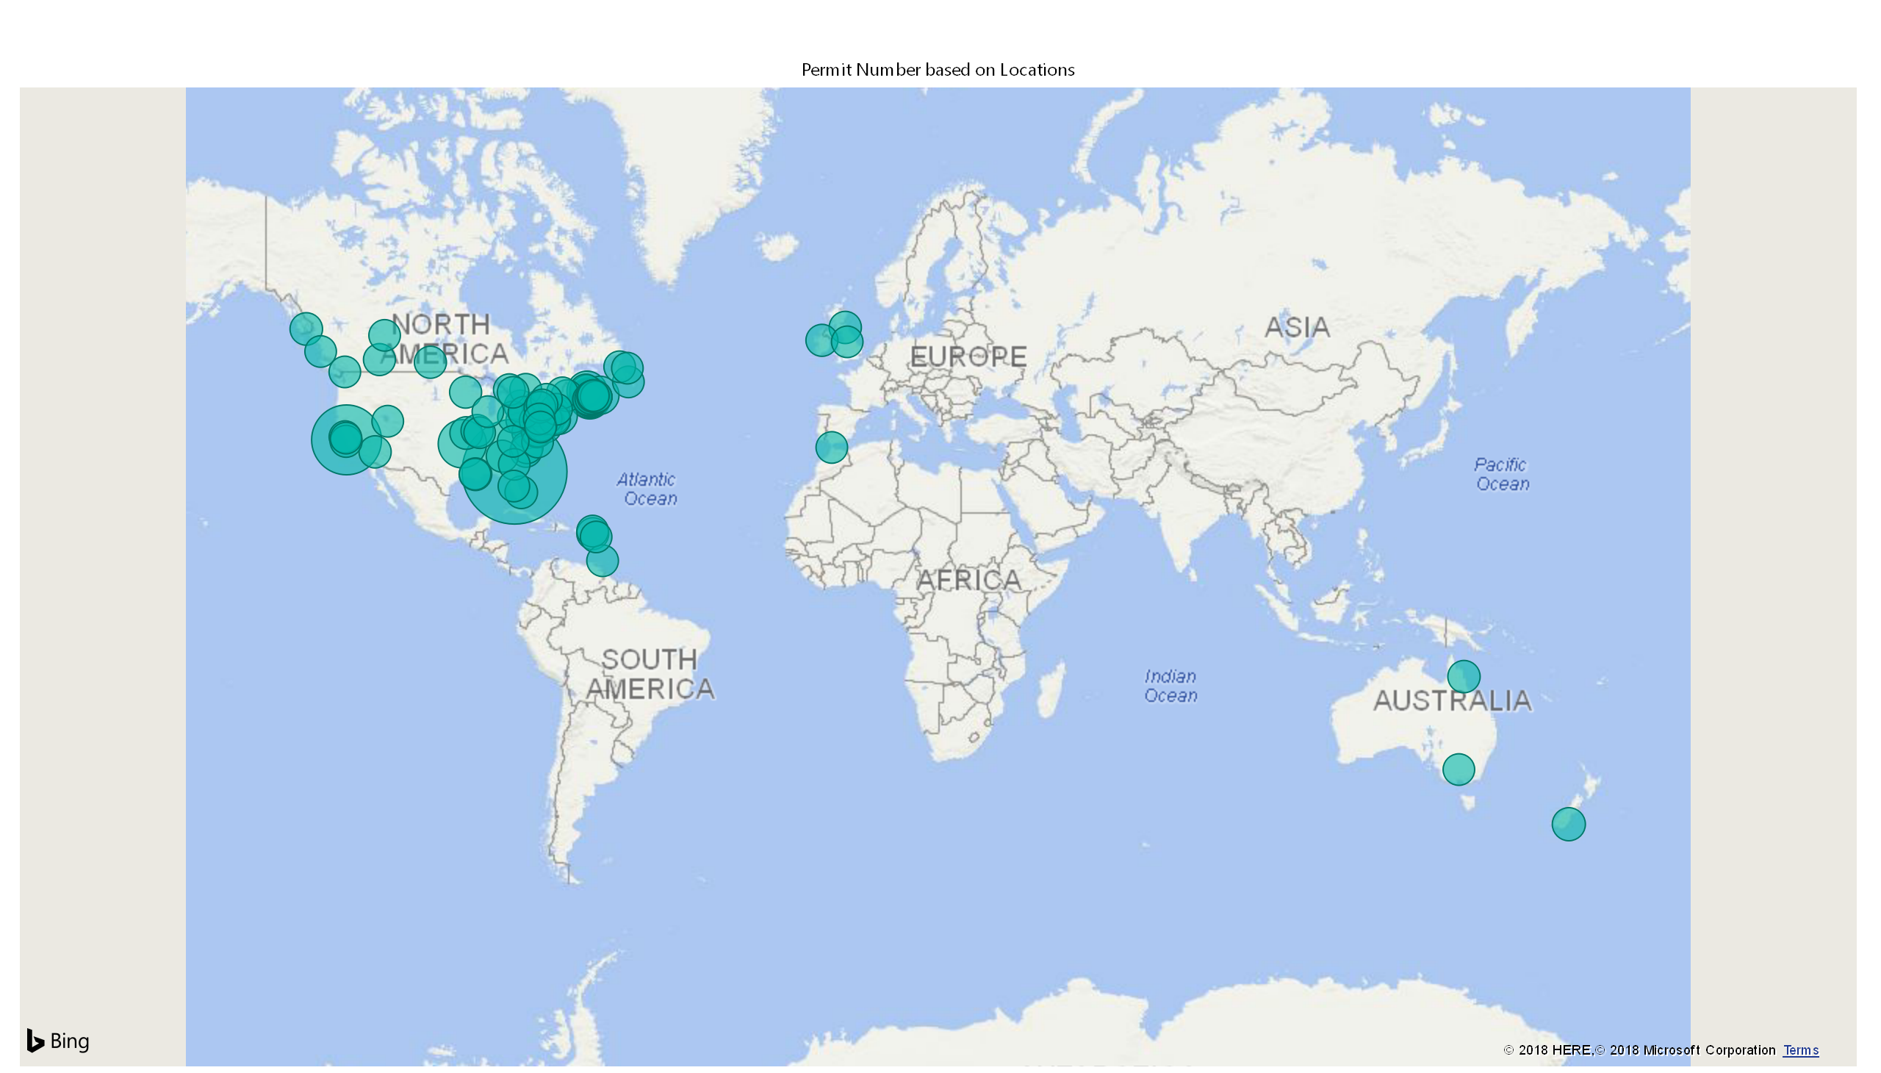

Slide 3
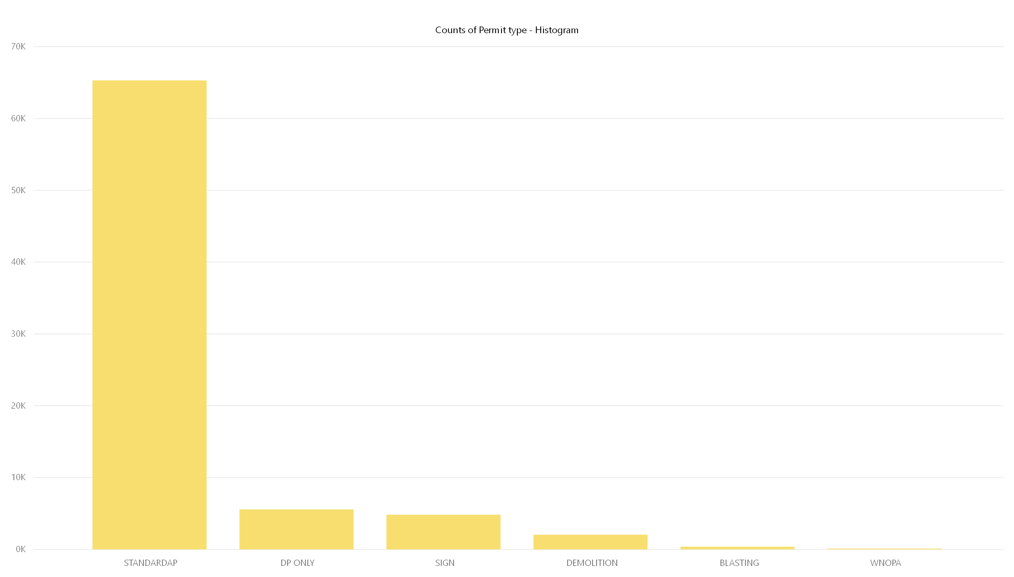

Slide 4
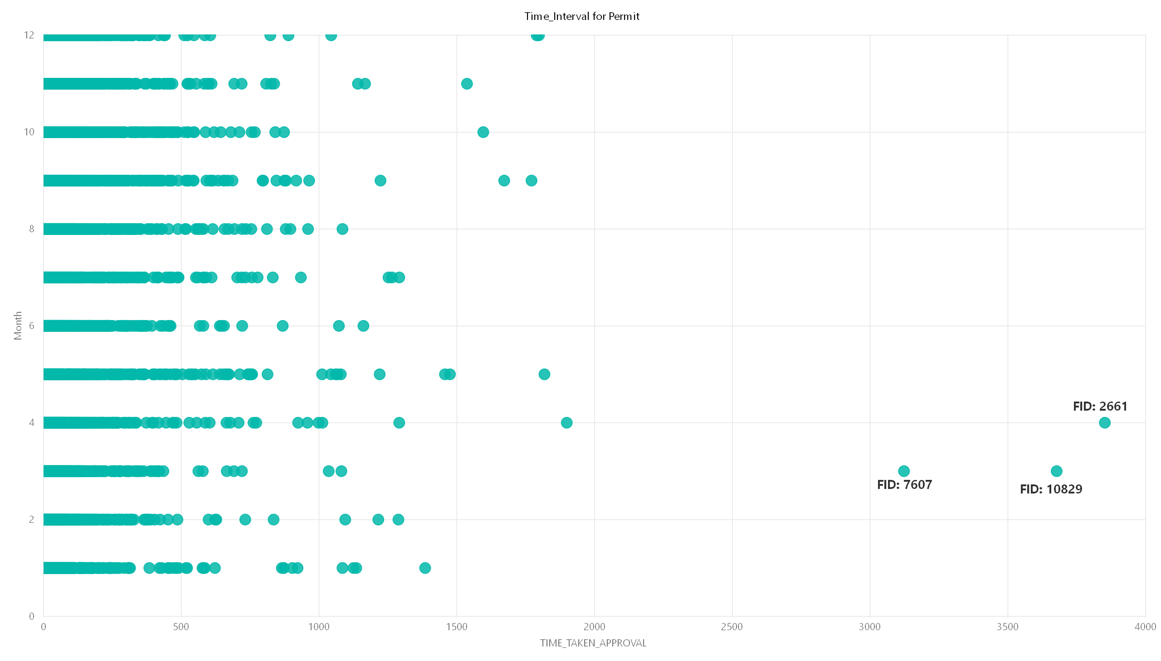

Slide 5
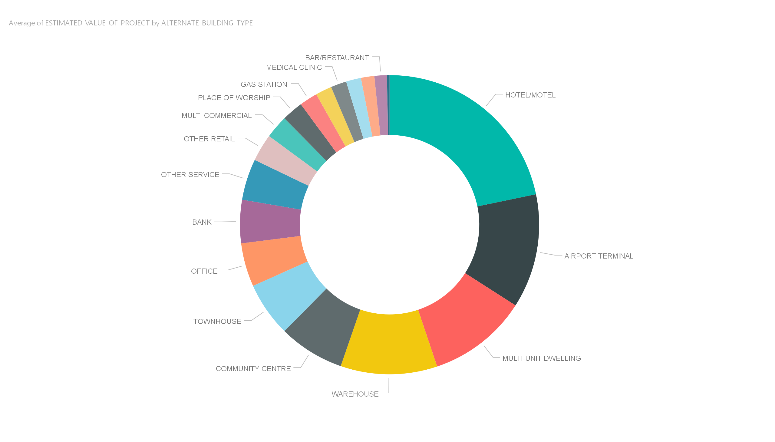

Slide 6
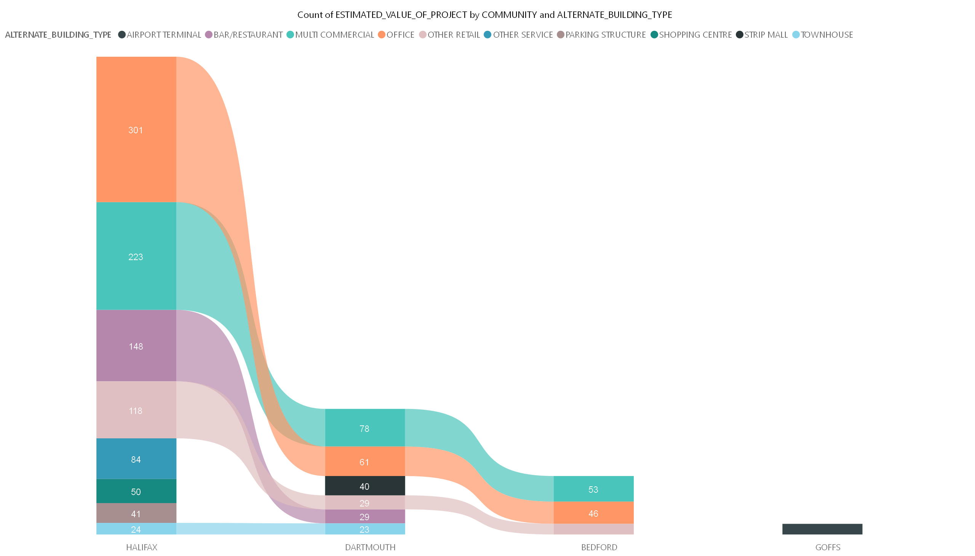

Slide 7
